Slide 1
Bioinformatics Summer Training RNA Institute, University at Albany Project Presentation Dr.Andam’s Lab Adebiyi Sefiyat
Notes:
Do not use a generic title, because everyone knows this is the Bioinformatics Summer Training. Use a title that reflects the objectives/findings of your specific research question. For example: “Amount of antimicrobial resistance genes across databases for Staphylococcus aureus from humans, carnivores, and Rodents”, if that’s the goal of your project 2. You can keep the current title as a small subtitle at the bottom of the page. Also, this is a good opportunity for you to tell the audience a little about yourself, your current institution, country, city, twitter account, anything you’d like to share.

Slide 2
Phylogenetic relationship and Antimicrobial Resistance Profile of Staphylocuccous aureus stains.
Background
Many bacteria has developed resistance to many antimicrobial and S.aureus is not an exception. With the aid of bioinformatics , data from different databses can be use to detect S.aureus strains antimicrobial resistance profile as well as the phylogenetic relationship in different host.
Using Data from Richardeson and el at on Staphylococcus jump ,This Project is interested in investigating the consistency of AMR gene in 3 hosts( canine,rodents and human)across three genomic databases which are NCBI,CARD and VDFB
Notes:
Strains is misspelled. The block of text you have provides important information, but no one is going to read it. Instead, add bullet points to remind yourself of what you want to say about this pathogen.

Slide 3
Objectives
To build phylogenetic tree of staphylococuss aureus in the three host so as to depict their evolutionary relatedness
To demostrate how consistency Amr gene data are across different databases
To Plot Antimicrobial Resistance genes per host
Notes:
As I mentioned, the second and third objective are more relevant for you, but I believe the first one could be replaced to “Determine the evolutionary relationships between S. aureus strains isolated from humans, carnivores, and rodents”.
The title can be changed to Research questions, and rephrased as such, for example:
What are the evolutionary relationships between S. aureus from human, carnivores, and rodents?

Slide 4
Methodology
The data was downloaded and assemble using SRA and Spades respectively data from each databasea)
The genome was annotated and core genome build by prokka and panaroo
Phylogenetic tree was built with RAxML
Data was analysis and Visualized using R Studio.
Notes:
This is probably fine, but it depend on how you deliver the message. Also, this only covers what to do to build a phylogenetic tree and summarize metadata, which is fine, but I would change the title to: ”building a phylogeny to see the evolutionary relationships”
Then on the next slide I would present the results for that (your phylogenies and summaries of number of isolates per host).

Slide 5
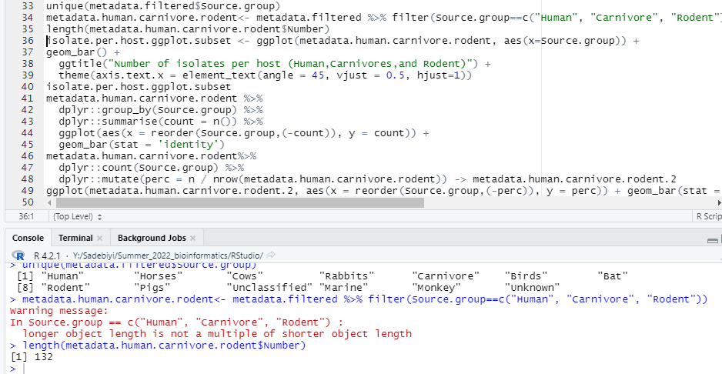
Dataset Summarization(boxplot)
The metadata of the S.aureus in the three host was summarised using boxplot.
When the metadata was filtered, it was observed the host share 132 strain of S.aureus among themselves
Notes:
I don’t think anyone will understand your code, they will just see blocks of text and not read it.
I would replace this with the boxplot you have on the next slide (left side) and your phylogeny (right side), highlighting the amount of isolates per host. And the title should be more informative rather than generic. We call those active titles, which are complete sentences and not just a statements. For example, if you make the changes suggested, I would change the title to: “Dataset biased toward S. aureus genomes from humans”, then explain how the total number of isolates could influence your findings.
Also, the warning in red in that code block means that you are not sub setting the data correctly (there are over 400 genomes from human S. aureus). I suggest using something like this:
#extract metadata for each sourcegroup separately
metadata.human <- metadata.filtered [metadata.filtered$Source.group == "Human",]
metadata.carnivore <- metadata.filtered[metadata.filtered$Source.group == ”Carnivore",]
metadata.rodent <- metadata.filtered.abricate[metadata.filtered$Source.group == Rodent",]
#merge datasets
metadata.human.carnivore.rodent <- rbind(metadata.human, metadata.carnivore, metadata.rodent)
#count the number of datapoints
Length(metadata.human.carnivore.rodent$Source.group)
#this last state should return more than 400 (because there are many genomes from humans)

Slide 6
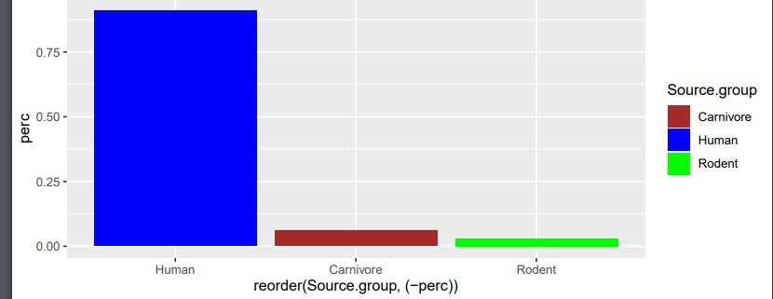
Metadata Summarization.
Human strain of S.aureus account for more than 75% of the shared strains among the the hosts
Notes:
This is fine, but if you keep it as is (look at my previous comment), you should have an active title, for example: “More genomes of S. aureus from humans were obtained”

Slide 7
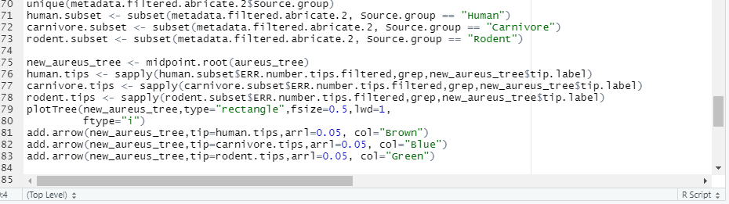
Phylogenetics Tree
A mid-rooted tree was constructed to show the evolutionary relatedness of staphyloccus aureus in the host.
This is the code snippet used in visualized the phylogenetic in Rstudio
Notes:
Again, a code block like this is not useful because no one will read it. It’s only useful when you are going to provide it afterwards and explain step by step what each line means.

Slide 8
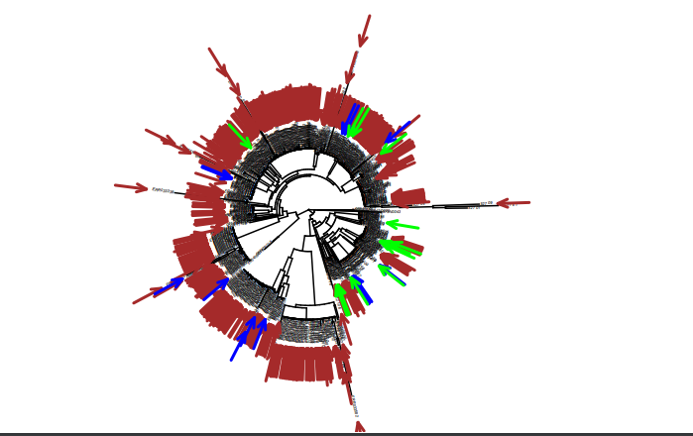
Phylogenetic Tree of Staphyloccus aureus inDifferent hosts
Human
Carnivore
Rodents
This tree clear show that the staphylococcus species in
Human carnivore and rodent are closely related
Notes:
What you have in black font is closer to an active title than the title in green. Also, I would say this figure is not very informative when you have so many human genomes. Maybe it would be informative if you make another figure excluding humans to compare. Still, I think the phylogenies made with ggtree are way more informative. I only provided this as another visualization example.

Slide 9
Antimicrobial Resistance Gene profile of the hosts.
Mass screening of genome was done for antimicrobial resistance or virulence genes using abricate.
This was done only with NCBI database
The AMR genes count was plotted per host (all hosts stated in the manuscripts)
Human S.aureus appear to have the highest number of AMR gene followed closely by the AMR genes in Carnivore and rodent among the three hosts that are being consider
Notes:
This is fine. I would just say it has too much text, but maybe if you separate the bullet points a little (adding one space in between), it would look a little better. The active title could be something along the lines of:
“Detecting antimicrobial resistance genes across three databases”.

Slide 10
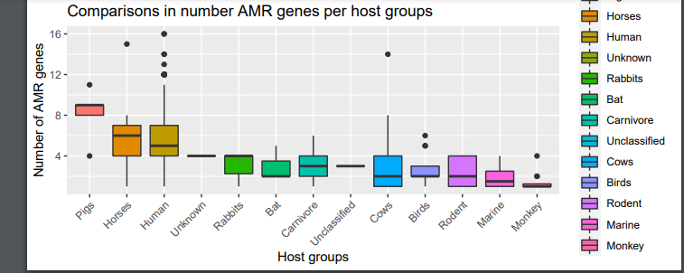
AMR gene boxplot
The hosts being consider are circle in brow
Notes:
This plot should include your hosts or host groups only and not all of them (that’s why you can’t even see the entire legend). Also, this looks like a screenshot from the examples provided. Anyway, I provided an example above regarding how to subset your dataset to keep your host/host groups only. Also, on the y axis and title you should emphasize that this is the ”average number of AMR genes per host” not the count (counts would be more for human because there are more for human).

Slide 11
AMR Gene Violin Plot
The AMR gene of the host was also plotted on voilin plot and t-test was use to see significance of the P-values from pairwise comparisons((human and carnivore),(Human and rodent), (carnivore and rodent)).
Notes:
No need to make an extra slide for this, remove.

Slide 12
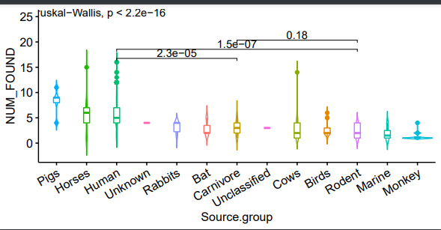
AMR Gene Violin Plot
The p-values of AMR gene in 2 groups (Human and Carnivore) and (Human and rodent)are lower than 0.05, suggesting significant (statistical) differences exist in the number of AMR genes found among these groups.
While the there is no significant difference in AMR gene count between Carnivore and Rodent(p value(0.18 )> than 0.05))
Notes:
Make a figure with your host/host groups only, not all of them because you would be covering someone else’s dataset. Your new figure including only your host/host groups could be placed on the same slide as the new version of the plot with your hosts only of the figure you have on slide 10. The difference between the two figures is that you would have a statistical test on this violin plot.

Slide 13
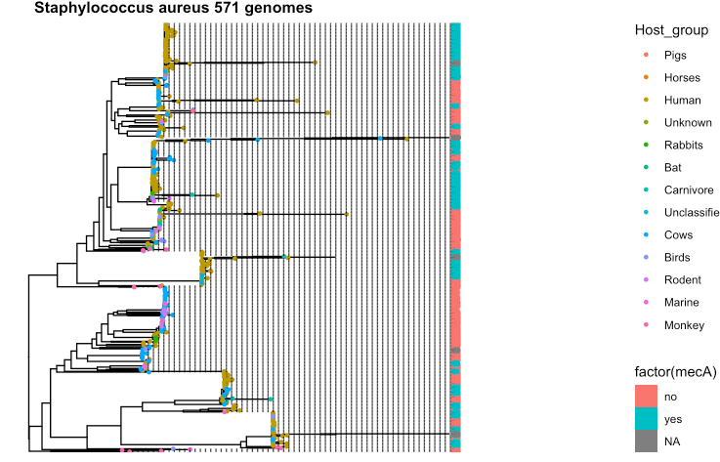
AMR Gene Phylogenetic Tree
One very common AMR gene was(mecA) was plotted on the phylogenetic tree to see its distribution.
Notes:
Plot your hosts only. You are focusing on human, carnivore, and rodent, so only those should be highlighted on this figure. I’ve already provided an example on how to subset those data from the metadata.filtered object (my comments on slide 5 of the current version). Also, you need an active title such as: “mecA gene common on human and…” it’s hard to tell, because the figure has all hosts.

Slide 14
AMR Gene Phylogenetic Tree
The phylogenetic tree shows that the AMR gene(mecA) in human than other host being considered
Notes:
This should be on the previous slide

Slide 15
AMR gene (Vfdb database)
Notes:
I suggest making a figure with counts across databases. I could help, but I would need you to try first and see if you can make it.

